Slide 1

Working Capital Management
Forecast to Deliver – Technique Paper
The full scope of Cash and Working Capital Management (CWCM) services is not permissible for SEC audit clients and their affiliates or IFAC PIE audit clients and their related parties. CWCM services are generally permissible for IFAC non-PIE audit clients subject to evaluating engagement circumstances using the conceptual framework (i.e. threats and safeguards approach) and provided we do not assume a management responsibility as outlined in the Global Quality & Risk Management Manual Chapter 11. See detailed guidance regarding Independence on slides 11-16 of the CWCM methodology guide.
RESTRUCTURING
August 2008
ADVISORY
For the purpose of this document, all references to KPMG International, a Swiss cooperative that serves as a coordinating entity for a network of independent member firms operating under the KPMG name, will be referenced as KPMG International. Throughout this document, "KPMG" ["we," "our," and "us"] refers to the local, independent KPMG member firm or firms. Throughout this document “client” [“they,” “their and “them”] refers to the local, independent member firm’s client. KPMG International provides no client services.

Slide 2
Introduction
  Title of Document: Forecast to Deliver Technique Paper
  Purpose of this document
  This technique paper covers the key processes and identifies main improvement areas within the Forecast to Deliver (FTD) cycle, as well as identifying tools and example tests. The tools comprise of: Data request, Guidance on holding workshop’s, Leading Practices, Diagnostic Questions, Suggested data analysis, Guidance on reporting and recommendations. For the Diagnostic Questions, please refer to the Cash and Working Capital Management Microweb (click here).
  Consider involvement of IT Advisory Services to help withdraw data from client’s ERP system
When and how to use this document: These tools and tests can be used by the practitioners when conducting the data analysis during a FTD diagnostic within the Assess phase of a Cash and Working Capital Management (C&WCM) engagement, to identify working capital opportunities.

Slide 3
Contents
Topics Covered Slide Number
Section 1: Working capital overview Slide 3
Section 2: Inventory management overview Slide 7
Section 3: Diagnostic Data Analysis Slide 18
Appendix 1: Inventory Management Network Slide 57
Appendix 2: Acronyms Slide 59
Appendix 3: Overview of Approach for Release of Working Capital Opportunities Slide 61

Slide 4
Section 1
Working capital overview

Slide 5
Working capital processes
  Three key processes comprise working capital as follows:
Component
Process
Key processes
Order to cash
(OTC)
  Customer acceptance
  Sales management
  Credit risk management
  Order management and invoicing
  Collection
  Dispute management
  Cash allocation
Revenue management
  Planning
  Sourcing
  Making
  Deliver and return
Working Capital
Inventory
management
Forecast to deliver
(FTD)
Expenditure management
Purchase to Pay
(P2P)
  Procurement strategy
  Supplier selection and contracting
  Requisition order management
  Receiving and supplier management
  Discrepancy management
  Invoice processing and payment management

Slide 6
Diagnostic Analysis Approaches
  To be able to identify Working Capital Opportunities, we aim to perform a detailed Diagnostic Analysis with the client. However, there may be a requirement to undertake a ‘lighter touch’ analysis ahead of performing the detailed Diagnostic Analysis. This may comprise either: a Desktop Assessment; or a Rapid Assessment. The differences in each approach are summarised below:
It is recommended to undertake a detailed Diagnostic Analysis instead of these steps
 | Desktop Assessment | Rapid Assessment | Detailed Diagnostic Analysis
Key people | Sponsor, Controllers | Sponsor, Controllers, Main Director Level Managers | All key people in organisation supporting WC processes
Objectives | Provides a very high level analysis and understanding of opportunities. Should support the case for a detailed Diagnostic Analysis. | To review and provide direction on which areas need to be included in Diagnostic phase To get buy in from local management and key decision makers for detailed Diagnostic Analysis | Identify and quantify opportunities to release cash from working capital
Activities | Remote, data driven analysis. High level questionnaires. Validation of findings. | High level Process Interviews with key people. Data Analysis. Validation of findings. | Workshops. Detailed process interviews. Define detailed gaps against leading practices and identifies opportunities.
Duration | 1 to 10 days depending on client complexity, number of location involved and client resource commitment. | On site typically 2-3 days per acre (OTC P2P FTD) country/business depending on client complexity. | On site typically 3-6 week per area (OTC P2P FTD) depending on client complexity.
Outcome | List of high level opportunities identified from questionnaires. | List of high level opportunities. High level process gap analysis and data analysis. Insights on possible actions to improve current performances. Actions and benefits to be validated more in detail during Detailed Diagnostic phase. | List of opportunities, with value, difficulty grid and related project plan. Report on findings opportunities. List of process gaps.

Slide 7
Forecast To Deliver
Suggested approach for a Detailed Diagnostic Analysis
Our approach
  Our approach will vary depending on the scope of work we will undertake. For a full diagnostic review of the FTD process, we would typically:
Example timetable | Action | Who is involved?
Pre-field work | Submit data request and gather data. | Finance, Operations Manager and IT.
Day 1 to 2 | Overview of Forecast To Deliver process. | Sales, Procurement, Production Planning and Scheduling, Manufacturing, Warehousing, Logistics.
Day 3 to 4 | End to end workshop to understand process and peoples’ roles and responsibilities. Detailed data analysis. | Sales Procurement Production Planning and Scheduling Manufacturing Warehousing Logistics
Day 5 to 11 | Detailed questions to each senior person in cycle. Review current reporting and monitoring. Detailed analysis to verify opportunities identified in questioning. | As above
Day 12 to 13 | End to end workshop to confirm findings and shape potential approach. | As above
Day 14 to 15 | Consolidate and report findings. Recommend next steps | KPMG/Senior management

Slide 8
Section 2
Inventory management overview

Slide 9
Inventory management
Overview
What processes are involved?
  Product portfolio and lifecycle management.
  Sales Operations and Planning (S&OP).
  Procurement and in-bound logistics.
  Manufacturing and assembly.
  Warehousing, distribution and logistics management.
  Reverse logistics management.
  Stock counting, monitoring and controlling.
What departments are involved?
  P2P is a cross-functional area which involves the following functions:
    Purchasing
    Finance
    Operations/Production
    Warehousing/Logistics
What are the overall objectives?
  To hold the optimal level of inventory across the overall supply chain to maintain the required customer service at the lowest cost which will:
    Avoid having too much inventory of the wrong products; and
    Minimise stock-outs and customer dissatisfaction.
  To align supply chain processes, assets and resources to this goal.
  In our experience this usually results in a lower inventory level.

Slide 10
Inventory management
Overview (cont.)
Typical benefits
  Reduced cash tied up in working capital.
  The appropriate inventory held in the right locations.
  Reduced levels of stock-outs/improved customer satisfaction levels.
  Cash released from inventory reductions, including lower safety and cycle stock levels.
  Simplified/rationalised product portfolio resulting in less complex and more cost effective supply chain requirements.
  Reduced waste/rework and obsolete stock, including strategies to convert slow moving items into cash.
  More accurate inventory requirements forecast.
  More collaborative partnerships with suppliers allowing for lower stock levels (e.g. just in time, kanban systems).
  Move to off balance sheet stock holdings (e.g. consignment stocks, vendor managed inventory).
  Reduced space requirements for RM and FG storage.

Slide 11
Inventory management
Supply chain – High level process map
Make to Stock Scenario
Plan
Source
Make
Deliver and return
Procurement
Organisation
S&OP
Procurement
Plan
Place order
Receive, verify
and store
RM inventory
WIP inventory
Manufacturing
Organisation
Manufacturing
Plan
Production
Schedule
Pick-up and
prepare RM
Produce
Store
FG inventory
Logistics/ Commercial.
Organisation
Distribution
Plan
Receive order
Distribution
Schedule
Distribute
FG, packaging, inventory
Goods return
FG inventory
Make to Order Scenario
Plan
Source
Make
Deliver and return
Logistics/ Commercial.
Organisation
S&OP
Distribution
Plan
Receive order
Distribution
Schedule
Distribute /
Return
WIP inventory
Manufacturing
Organisation
Manufacturing
Plan
Production
Schedule
Pick-up and
prepare RM
Produce
Store
FG inventory
FG inventory
Procurement
Organisation
Procurement
Plan
Place order
Receive, verify
and store
RM inventory

Slide 12
Inventory management
Key processes and main improvement areas
Plan
Source
Make
Deliver and return
  Supply chain strategy
  Materials procurement and replenishment
  Manufacturing detailed scheduling
  Distribution and warehousing
  Product life cycle management
  Material receiving
  Production execution
  Third party logistics management
  Sales and Operations Planning (S&OP)
  Suppliers conditions and performance
  WIP management
  slow moving and obsolete stock management

Slide 13
Inventory management
Key issues and KPMG approach – Plan
Plan
Source
Make
Deliver
and
return
Key issues |  | Potential KPMG approach
Lack of a robust supply chain (SC) strategy: Make vs. buy alternatives not considered No product categories defined to managed inventory Manufacturing/storage network not optimised to support business needs and while minimising inventory cost Unclear balance between service levels and inventory |  | Review, redesign and implement a consistent supply chain strategy considering to optimise inventory, cost and service level across the whole SC SC strategy could also include other factors such as tax and carbon efficiency optimisation
Limited/inexistent product lifecycle management: Many SKU with minimum, negative or no impact on profit adding complexity to the supply chain Lack of formal policies and procedures to take out SKUs from the portfolio (e.g. ‘One in, one out’) New product development process (NPD) not designed to minimise failures and obsolescence Product development not coordinated with sales, marketing and procurement Reactive and ad-hoc obsolete inventory reduction initiatives |  | Formalise a product lifecycle management process Redesign the NPD process based on a gateway based approach Help to redefine SKU portfolio management policies Identify and put in place obsolescence prevention initiatives as part of an obsolete reduction programme
Lack of an effective S&OP process Inaccurate forecast Disintegrated planning processes (silo mentality across the supply chain- from sales forecast to procurement forecast) Poor adherence to plans |  | Design and implement an integrated end-to-end S&OP process Bring together sales, demand managers and planners into an efficient demand planning process Provide tools and techniques to improve forecast accuracy Develop appropriate reports and KPIs to measure and communicate forecast accuracy

Slide 14
Inventory management
Key issues and KPMG approach – Source
Plan
Source
Make
Deliver
and
return
Key issues |  | Potential KPMG approach
Replenishment and material receiving processes do not support inventory optimisation: Highly manual processes relying on ad-hoc reports and Excel spreadsheets data Batch sizes driven by transport cost and other factors but inventory; Orders sent to suppliers without sufficient notice (e.g. without considering lead time) Lack of adherence to replenishment and material receiving policies |  | Streamline the replenishment process Review and redesign the process, including the use of automated tools/systems Redefine policies, rules and procedures Re-evaluate batch sizes, lead times, and other parameters balancing inventory cost vs. other costs Review and redesign material receiving process Map process and identify gaps Review linkage with other cash related processes (e.g. payables)
Poor vendor reliability Contracted lead times not met Deliveries do not arrive on time/in full Outdated parameters in the suppliers master data Suppliers performance not properly monitored Lack of processes and KPIs to track suppliers performance Poor performance remains unchallenged Inventory is build up to compensate lack of reliability |  | Work with the client and its suppliers to help improve performance Joint workshops to understand each other’s issues and to develop mutually beneficial approach Develop tools and processes for monitoring suppliers’ performance Implement appropriate KPIs that accurately reflect performance and allow a meaningful communication with the supplier
Supplier agreement conditions not used as a leverage to improve inventory performance Vendor performance KPIs not part of contract Lack of consignment stock and other agreements to delay inventory ownership Limited use of penalties and agreed clauses enforcement |  | Review supplier agreements with the view to reduce inventory holdings Provide observations and recommendations Help to negotiate and implement consignment stock and similar agreements with suppliers

Slide 15
Inventory management
Key issues and KPMG approach – Make
Plan
Source
Make
Deliver
and
return
Key issues |  | Potential KPMG approach
Poor manufacturing schedule adherence Incorrect master data cause scheduling errors that can result to over- or under-stocks Significant manual intervention required Materials arriving not in line with plan Poor communication with planning and purchasing |  | Review and redesign of the scheduling aligned with the S&OP process Recommend a master data strategy and work with the client to implement it Develop process for regular maintenance Develop and establish processes for timely and effective communication between departments
Production floor inefficiencies Frequent and long changeovers Production bottlenecks Unbalanced stocks Inefficient material handling equipment Equipment not optimum for the kind of goods handled Can cause delays and backlogs |  | Assess the applicability of Lean and Six Sigma manufacturing principles and determine the possible financial impact. Design and facilitate tailored Lean and Six Sigma programmes Assess and recommend changes to product handling Map and review current handling processes Identify inefficiencies such as double-handling, long waits, etc and develop revised optimum processes Advice on best use of existing equipment
Work In Progress inefficiently managed Poor visibility of WIP inventory WIP inventory causing space issues on the shop floor No use of kanban or other inventory flow techniques No implementation of late differentiation strategies |  | Develop and implement strategy for WIP management Evaluate current levels of WIP and their influence on operation and total stock levels Implement kanban an other inventory management techniques Include WIP in the inventory management system to help ensure visibility Implement late differentiation techniques to help ensure responsiveness and balanced FG stocks

Slide 16
Inventory management
Key issues and KPMG approach – Deliver and return
Plan
Source
Make
Deliver
and
return
Key issues |  | Potential KPMG approach
Unclear policies/criteria for allocating inventory across the distribution network Inventory location does not reflect customer service agreements and supply responsiveness Unbalanced inventory across warehouses Visible high stock levels – warehouse full DCs struggling to cope with high levels of stock, resulting to reduced throughput and customer service issues Expensive contract storage often required Stock holding not matching demand Stock is sufficient overall but held at the wrong place Expensive premium rate movements to satisfy demand Poor picking accuracy High level of errors and damages on picked orders Poor customer satisfaction and high returns Under-developed reverse logistics No returns management process Returns occupy space and resources in the DCs, reducing capacity No agreements for returns to suppliers |  | Network analysis to determine optimum stock holding locations Hold stock higher in the supply chain Establish most effective transport options Assess total stock holding and identify reduction opportunities Run inventory model to determine optimum inventories Establish systems for tracking stock levels and taking corrective actions Develop and implement appropriate systems for order picking Assess current systems and identify shortcomings Develop optimum processes in line with product and current equipment Develop and implement a reverse logistics process Fast turn around of customer returns, minimizing impact on space and working capital Maximise recovery from returns and damages Help establish return agreements with major suppliers

Slide 17
Inventory management
Key issues and KPMG approach – Deliver and return (cont.)
Plan
Source
Make
Deliver
and
return
Key issues |  | Potential KPMG approach
Performance of 3PL providers does not meet expectations Performance not accurately monitored Not sufficient in-house expertise to challenge third party Relevant KPIs not included in the contractual agreement |  | Develop tools and reports for measuring 3rd parties’ performance Provide relevant expertise and benchmark against industry standards Develop appropriate KPIs and include performance related conditions in the agreement
High levels of slow moving and obsolete stock Taking valuable space in the warehouse Product deteriorates and is more difficult to sell Often a significant contributor to working capital |  | Develop tools and processes for effectively managing slow moving and obsolete stock Advice on exit roots for existing stock Include slow moving in every day stock management

Slide 18
Inventory management
Warning signs of issues in inventory management
Warning signs
  SKU proliferation (many new SKUs and no evidence of SKUs being taken out of the portfolio)
  Lack of visibility over forecast inventory requirements
  Forecast/plans poorly integrated across the value chain (sales, manufacturing, procurement)
  Increasing in-bound logistics cost
  Low reliability of suppliers
  Poor adherence to production schedules
  Stock build-ups along the production line
  Made to order products are held on inventory
  Increasing inventory write-offs and higher obsolete and slow moving stock
  The warehouse is running out of space or seems to be poorly managed
  Decreasing service levels (on-time in full deliveries) in spite of increasing stock levels
  Increasing level of customer returns / stock cleanses
  Slow moving SKUs being held in multiple warehouses
  Poor control of returned stock (e.g. packaging, return items, etc,)
  Significant differences between physical stock and reported figures in the system

Slide 19
Section 3
Diagnostic Data Analysis

Slide 20
Diagnostic data analysis
Tools and tests
DA | RA | DD | Tool/analysis |  | Purpose | Level of complexity | Process | Page
√ | √ | √ | 1. | Days of Inventory Outstanding (DIO) and Days of Inventory Available (DIA) calculation | Provide a standardised measure of the inventory level, allowing to compare it among different periods of time and different competitors, regardless of the absolute value and taking into account demand behaviour | Low | All | 21
 | √ |  | 2. | Allocated inventory analysis | Identify inventory that has been allocated to a client order for a significant time (and therefore not available for sale) , but has not yet been shipped/invoiced | Low | Delivery | 23
 | √ |  | 3. | Inventory records accuracy | Validate how well the inventory balances on file reflect actual balances when compared to the physical inventory results. | Low/ Medium | All | 25
 | √ |  | 4. | Inventory mapping | Get a clear picture of the types, quantities, and locations of stock in the Supply Chain, and to perform further analysis to optimize it. | Low/ Medium | Source, Make, Deliver | 26
 |  | √ | 5. | Demand profiling | Classify sales based on criteria such as customer segment, product types to get a high level understanding of the demand and how predictable is it. | Low/ Medium | Plan, Deliver | 29
√ | √ | √ | 6. | Inventory coverage analysis | Assess current inventory levels by SKU by days or weeks forward coverage (or as a percent to target). | Medium | All | 30
 |  | √ | 7. | Consignment stock analysis | Identify potential excesses or inefficient use of inventory in the consignment stock agreed with customers. | Medium | Source, Deliver | 33
 |  | √ | 8. | Inventory segmentation | Segment SKUs based on similar behaviour reflecting how the business works. | Medium/ High | All, emphasis on Plan | 35
 |  | √ | 9. | Time series analysis of inventory | Identify shifts in supply performance or identify areas where the environment has changed over time | Medium/ High | Plan | 40
 | √ |  | 10. | Late deliveries analysis | Identify the main reasons for late deliveries and their impact in the overall performance. | Medium/ High | Source, Make, Deliver | 41
 |  | √ | 11. | Demand standard deviation and MAD | Measure demand variability in order to understand how predictable or volatile it is. | Medium/ High | Plan, Deliver | 42
 | √ |  | 12. | Forecast accuracy analysis | Assess the level of accuracy of the existing forecast method being used by the client and identify potential areas of improvement. | Medium/ High | Plan | 44
Key:
DA Desktop Assessment
RA Rapid Assessment
DD Detailed Diagnostic Analysis

Slide 21
Diagnostic data analysis
Tools and tests
DA | RA | DD | Tool/analysis |  | Purpose | Level of complexity | Process | Page
 |  | √ | 13. | Actual versus theoretical inventory targets | Assess whether existing stock parameters (EOQ, MBS, and ROP) are too high when compared against theoretical levels. | High | Plan | 47
 |  | √ | 14. | Review of current stock parameters | Assess whether parameters such as Economic-Order-Quantity (EOQ), Minimum Batch Size (MBS), Reorder-Point (ROP) are very conservative or not being properly calculated | High | All | 49
 |  | √ | 15. | Fill rate and lead time analysis | Assess actual service level and identify potential inconsistencies among the service level offered and provided for different customer segments, products, etc | High | Make, Deliver | 52
Key:
DA Desktop Assessment
RA Rapid Assessment
DD Detailed Diagnostic Analysis

Slide 22
Diagnostic data analysis
1. Days of Inventory Outstanding (DIO) and Days of Inventory Available (DIA) calculation
Objective
Provide a standardised measure of the inventory level, allowing to compare it among different periods of time and different competitors, regardless of the absolute value and taking into account demand behaviour
Indicate how long it will take to consume the existing stock based on historical (DIO) or forecasted demand (DIA)
Benefits
Focus attention on ‘how well inventory is managed?’ instead of ‘how much inventory is held?’
Provide an initial understanding of the improvement potential
‘Handle’ better the sales seasonality than measuring in absolute terms (£, units, etc.)
How to do it
For the SKUs you want to analyze gather their inventory level as well as their Cost-of-Goods-Sold (COGS) or sales during the last 12 months
Calculate DIO, or DIA following these guidelines: (Sales can be replaced by COGS if available)
Plot DIO (or DIA) into a chart and compare performance
Method | When to use it | DIO for period P (DIO_{p}) | DIA for period P (DIA_{p})
Direct | Unknown sales behaviour ‘Quick and dirty’ approach | DIO_{p}= inventory x days in period_{p}/sales_{p} | DIA_{p}= inventory x (days in period_{p+1})/forecasted sales_{p+1}
Annual average | Sales are similar and stable throughout the year | DIO_{p}= inventory x 365/ sales last _{12 months} | DIA_{p}= inventory x 365/ forecasted sales next _{12 months}
n-months average | Sales with seasonality pattern | DIO_{p}= inventory x days in n-months/ sales last _{n- months} | DIA_{p}= inventory x days in n-months/ forecasted sales next _{n- months}

Slide 23
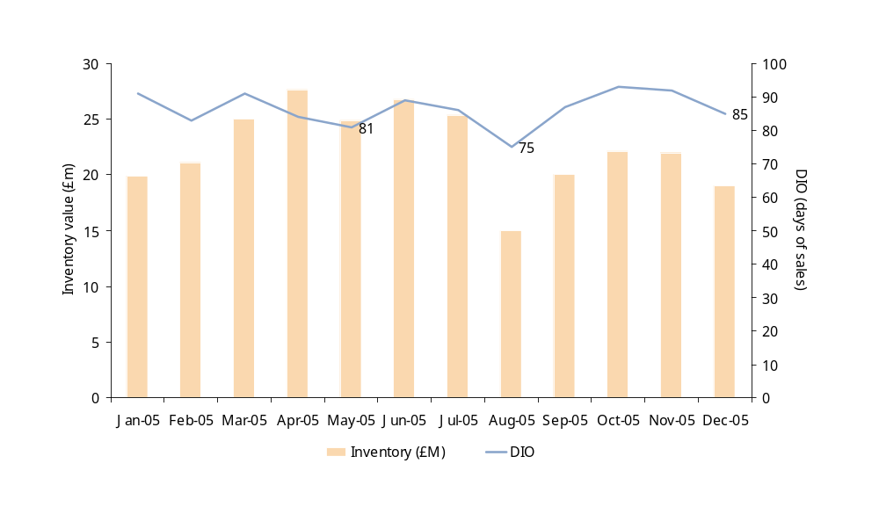
Diagnostic data analysis
1. Days of Inventory Outstanding (DIO) and Days of Inventory Available (DIA) calculation (cont.)
By looking at the chart you can get a quick insight into the stock performance and do a first calculation of expected benefits (assuming that the best historical performance can be achieved and sustained)
Average DIO=86
Benefit range
Upper limit
Average DIO = 86
Best historical DIO = 75 (August 2005)^{(a)}
Difference (gap) = 11 days
1 day of sales = £259,000
Potential opportunity = 11 x £259 = £2,854
Lower limit
Average DIO = 86
Second best DIO = 81 (August 2005)
Difference (gap) = 5 days
1 day of sales = £259,000
Potential opportunity = 5 x £259 = £1,297
Note: (a) Before considering the lowest DIO, question if there are any special business circumstances that are not sustainable during the rest of the year (e.g. Low August inventory sometimes relates with summer season)

Slide 24
Diagnostic data analysis
2. Allocated inventory analysis
Objective
  Identify inventory that has been allocated to a client order for a significant time (and therefore not available for sale) , but has not yet been shipped/invoiced:
    Because the client has not called the order yet;
    Because the order has not been completed;
    Because the order was cancelled and system was not updated.
  Identify inventory of MTO SKUs that has been produced long time before order delivery date.
Benefits
  Raises visibility of inventory that could be easy to sell but sometimes neglected by the client or hidden by the system.
  Provides insight into issues relating lack of coordination between the commercial and operations departments.
  Highlights potential issues regarding commercial policies and practices regarding the allocation of inventory to orders, early production or lack of enforcement of commercial agreements with customers.
How to do it
  If the system allows to identify the existing inventory that is allocated to customer orders, list the SKUs in this category. If not ask the commercial department to provide you with that data (make sure total inventory figures add-up).
  Although data may not be available to identify the age of allocated inventory exactly, this analysis can be done using related date fields, to give approximate results. An alternative could be to use the date of some related event, e.g. order entry, production, promised delivery, or last inventory movement. Note: Ideally we would use promised delivery date but in many systems this data is unavailable or unreliable.
  Sort SKUs in descending order in terms of value and age and ask the commercial department to identify, at least for the most important SKUs, the reason for been in this list. Alternative reasons could include:
    Cancelled order
    Delivery not arranged yet
    Order not yet due
    Incomplete order
    Client on-hold (e.g. credit dispute)
    Order rejected by client

Slide 25
Diagnostic data analysis
2. Allocated inventory analysis (cont.)
Order number | Product | Total tonnes | Pending tonnes | Weeks since production | Reason
510373 | HEA-200 | 2245 | - | 63 | Dispute
510367 | IPE-300 | 9145 | - | 34 | Dispute
566265 | HEA-200 | 5158 | - | 19 | Rejected
508906 | IPE-270 | 2392 | 5 | 17 | Rejected
570202 | HEA-200 | 4523 | - | 17 | Port
570263 | IPE-270 | 2354 | - | 15 | Port
570238 | IPE-240 | 2354 | 350 | 15 | Incomplete
570224 | HEA-220 | 10316 | 121 | 15 | Incomplete
570220 | IPE-200 | 18597 | - | 15 | Port
570222 | HEB-280 | 4914 | - | 14 | Delivery not arranged
570223 | IPN-340 | 3786 | - | 13 | Delivery not arranged
570295 | IPN-240 | 8863 | 222 | 13 | Incomplete
570267 | IPN-220 | 14157 | 1,211 | 12 | Incomplete
531900 | HEB-240 | 4626 | - | 10 | Delivery not arranged
532567 | HEB-140 | 9647 | - | 9 | Port
570690 | IPE-200 | 9473 | - | 9 | Delivery not arranged
566646 | IPE-200 | 5054 | - | 9 | Delivery not arranged
566236 | IPE-200 | 9393 | - | 9 | Delivery not arranged
566235 | IPE-240 | 8898 | 870 | 9 | Incomplete
566827 | IPE-240 | 1255 | - | 8 | Delivery not arranged
569073 | UPN-200 | 2666 | - | 8 | Delivery not arranged
568527 | IPE-300 | 10116 | - | 7 | Delivery not arranged
566220 | IPE-220 | 9419 | - | 6 | Delivery not arranged
569597 | HEB-240 | 4985 | 3,888 | 6 | Incomplete
570682 | UPN-180 | 4777 | - | 6 | Delivery pending
566337 | IPE-220 | 4733 | - | 5 | Delivery pending
566259 | UPN-180 | 4777 | - | 4 | Delivery pending
571124 | IPE-600 | 2530 | 490 | 3 | Incomplete
566256 | IPE-600 | 2508 | - | 2 | Not yet due
566539 | IPE-600 | 2454 | - | 2 | Not yet due
567565 | UPN-240 | 1234 | 769 | 1 | Not yet due
567574 | HEA-200 | 2133 | - | 1 | Not yet due
508508 | IPE-200 | 15035 | - | 1 | Not yet due
By looking at the allocated inventory analysis you can do an estimation of inventory reduction opportunities, considering alternatives such as:
  If the SKU is a MTS, unblock it and make it available for future orders.
  If the SKU is waiting for order completion, discuss giving priority to order completion and delivery.
  If delivery date has not been arranged, discuss with commercial department feasibility to arrange delivery.
  If the SKU is MTO discuss with commercial feasibility of arranging delivery or need to move SKU to an slow moving and obsolete reduction programme.

Slide 26
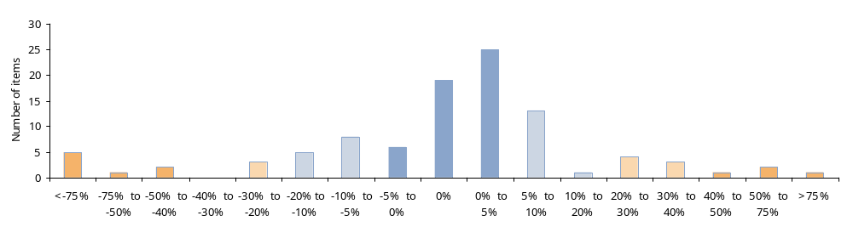
Diagnostic data analysis
3. Inventory record accuracy analysis
Objective
  Validate how well the inventory balances on file reflect actual balances when compared to the physical inventory results.
Benefits
  Provides insight into issues relating data maintenance and inventory control procedures.
How to do it
  Prepare separate exhibits for finished goods and raw materials for each distribution centre, manufacturing facility, storage facility, etc.
  Use the book inventory at the time of the most recent physical inventory or a snapshot of the latest physical record. These should be the inventory records used by materials management to plan and order materials.
  Subtract the physical values from the book inventory values and divide by the physical to get the variance or error for each SKU.
  Graph error as an histogram reflecting the number (or percentage) of SKUs per error level terms are best graphically displayed to illustrate current inventory records accuracy performance.
  By looking at the histogram you can identify if record accuracy is or not an issue. Inventory records accuracy is most important with low target.

Slide 27
Diagnostic data analysis
4. Inventory mapping
Objective
  Get a clear picture of the types, quantities, and locations of stock in the Supply Chain, and to perform further analysis to optimize it.
  Understand (define) who is responsible for overseeing each type of stock at each possible stage in the supply chain.
Benefits
  Provides a quick and complete overview of the location of the stock across the supply chain.
  This straightforward exercise will generally be a revelation for the client and very useful to set priorities and focus effort.
  Its value comes from representing the inventory with a simple physical measure that is easy to understand – days.
How to do it
  List all the different possible inventory types, including as many subcategories as it worth detailing (based on its economical value, strategic importance or other criteria).
  List all the different inventory Holding Points across the Supply Chain, indicating the type of inventory to be found at each point.
  Create a matrix inventory Category-inventory Holding Point, indicating for each type of inventory at each inventory holding point:
    Current amount of inventory (Units, value and DIO)
    Average inventory in the last three months
    Average use/consumption in the last three months
    Purpose of this inventory (e.g. Safety inventory, export to x country, etc.)
    Person responsible for controlling this inventory
  Draw a high level map to reflect the flow of materials through the supply chain, showing the different stocking points as well as the value created at each stage (See both analysis in the next slide).

Slide 28
Diagnostic data analysis
4. Inventory mapping (cont.)
Stock map — Matrix format (Steel manufacture example)
Stock
location
Stock type
Purpose
Avg. Inventory
Last 3 months
(units)
Avg. consumption
Per month - last
3 months
(units)
Current
DIO
Target
DIO
Value (£ M)
Central Stock
RM
Raw
Materials
Allow lower cost
for volume
purchases
80,000
120,000
20.0
10
42.8
In-house RM
Raw
Materials
Cover period
between deliveries
Safety in case of
delivery interruption
25,300
30,000
25.3
13
13.5
Semi-finished
stock
Semi-finished
Balances plant 1
and plant 2
capacity
20,100
29,600
20.3
10
10.5
FG In-house
Finished
Goods
Cover sales with
delivery in less than
1 week
FG waiting for loading
44,500
36,700
36.4
20
53.4
Distributor
A
Finished
Goods
Consignment stock to
supply region A
customers
15,800
8,000
59.3
10
18.9
Domestic
Port
Finished
Goods
Sales waiting for boat
departing in 2 weeks
Safety stock for
exports
8,300
7,500
33.2
30
30.0
Key
Total WIP/stock in £,000 and DIO
Labour
981
Overheads
982
Stock map — Value Added Diagram (Pottery example)
Total value ‘transferred’ to next process
Material value added during process
Materials
532
25
(3.8 days)
2,495
£(,000)
Labour
981
Overheads
982
Labour
37
Overheads
185
Labour
581
Overheads
539
Labour
434
Overheads
206
Labour
121
Overheads
29
Labour
234
Overheads
539
Clay-making
25
(3.8 days)
Biscuit
111
(9.8 days)
Decorating
31
(2.0 days)
Glost
Unselected
78
(3.8 days)
Glost
selected
199
(8.9 days)
Finished
Goods
699
(27.4 days)
Materials
532
2,495
2,715
4,353
5.064
5,214
6,499
11
Materials
518
Materials
71
Materials
840
Materials

Slide 29
Diagnostic data analysis
4. Inventory mapping (cont.)
  With the initial understanding obtained from these two tools some questions can be asked to identify potential opportunities to gain a better control of stock or to optimize it.
  These questions might include:
    Where is most of the inventory? Are the amounts (units, days, euros) ‘reasonable’?
    Are all the stock holding points clearly controlled? Do all of them have somebody responsible for them?
    Are there any stock holding points with apparent excess or potential stock-outs risk? (e.g. 125 days at domestic port)
    Is there any duplication of stock among different stock holding points?
    Do days coverage match team’s experience of how long processes take and supplier lead times?

Slide 30
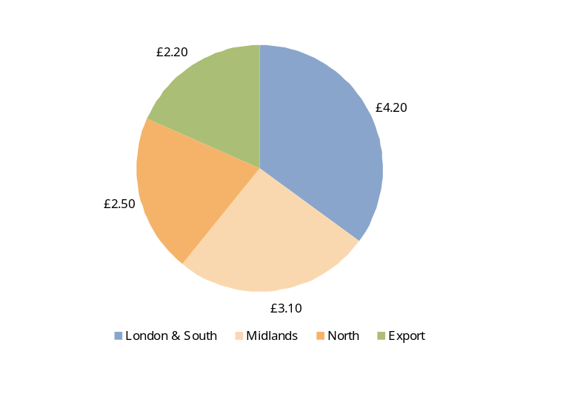
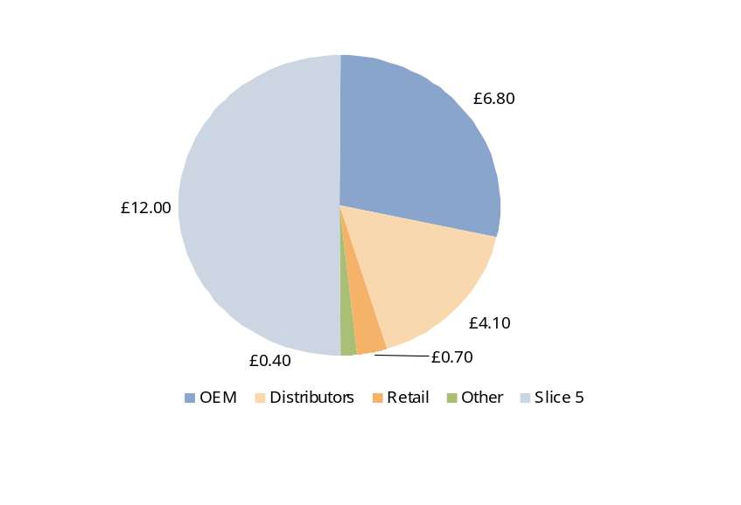
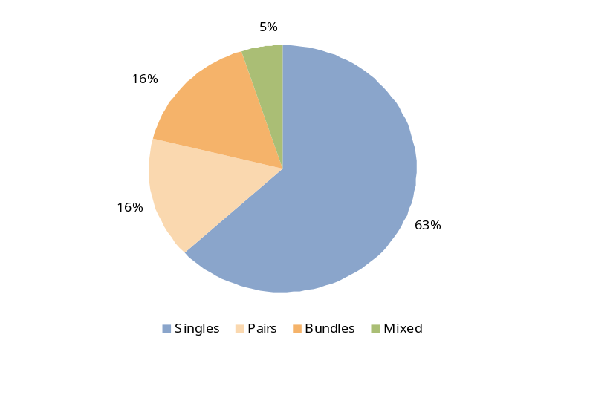
Diagnostic data analysis
5. Demand profiling
Objective
  Classify sales based on criteria such as customer segment, product types to get a high level understanding of the demand and how predictable is it. The more volatile the demand the more difficult it would be to forecast.
Benefits
  Straightforward and easy to do. In most cases this analysis is already available in client’s reports.
  Provides goods insight and helps to help ensure attention is focused on the right issues.
How to do it
  Gather historical sales data, identify demand drivers and define categories based on these drivers (see examples).
By geographical location
By customer segment
By product format
Other demand drivers might include:
  Product/service category
  Product use
  Order size
  Product customization
  Etc…
  Based on these classifications, evaluate how predictable the demand is for each segment and question what differences could exist (if any) in forecasting sales for each segment.
  Make sure you discuss these issues during the interview.

Slide 31
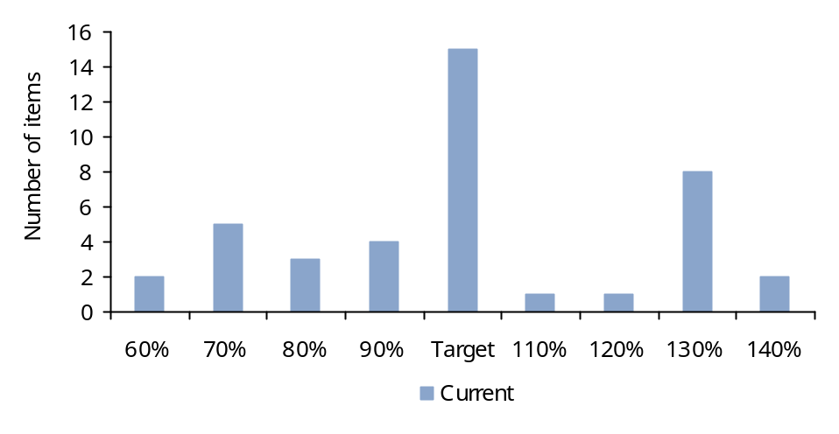
Diagnostic data analysis
6. Inventory coverage analysis
Objectives:
  Assess current inventory levels by SKU by days or weeks forward coverage (or as a percent to target).
  Compare actual inventory against existing targets.
Benefits:
  Provides a snapshot of how well the ‘system’ is managing to target.
  Quickly identifies those SKUs in short supply or with heavy excess.
  Helps to demonstrate how seemingly adequate total inventories can produce poor results.
  Provides insight into current service issues.
  Indicates potential shortfalls in existing processes, procedures, and policies.
How to do it:
  For the SKUs you want to analyze gather their current or average inventory level during the last 12 months as well as their inventory target.
  Express current (or average) inventory level as a percentage of target.
  Sort SKUs in ascending percentage and group them on a histogram.
  Plot histogram in to a chart where the X-axis represents the percentage of target, and the y-axis represents the number of SKUs (or a percentage of the number of SKUs).
  Ideally, the histogram will show that the inventory levels are distributed approximately equally around the inventory target.
  When the analysis is done with the current inventory level, the distribution will be more spread than when doing the analysis with average inventory values.
Ideal distribution (normal)

Slide 32
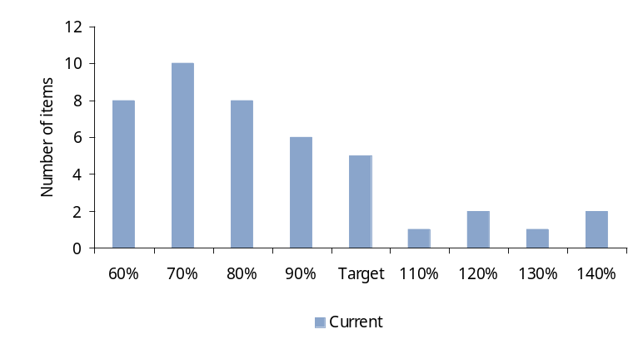
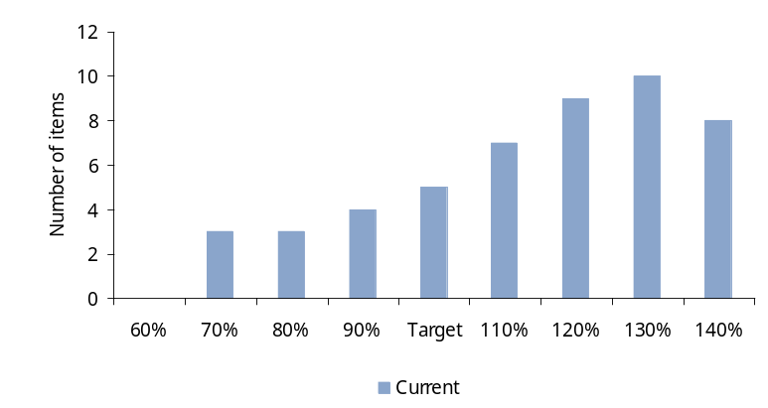
Diagnostic data analysis
6. Inventory coverage analysis (cont.)
By looking at the inventory coverage chart you can yield valuable insight about potential inventory management issues
  You can also do a first estimation of inventory reduction opportunities (moving SKUs with inventory excess closer to target).
  And focus your analysis in a smaller number of SKUs (those with behaviour outside the expected normal pattern).
The typical unbalance scenarios are three:
Right tail
Many SKUs under-stocked
  Recent indiscriminate inventory reduction programme.
  Significant level of stock-outs.
  Demand quicker than replenishment or unexpected.
  System not being updated with new targets.
Left tail
Many SKUs over-stocked
  Potential existence of obsolete stock.
  Very high service level for all products.
  Procurement or production batch sizes much higher than demand.
  System not being updated with new targets.

Slide 33
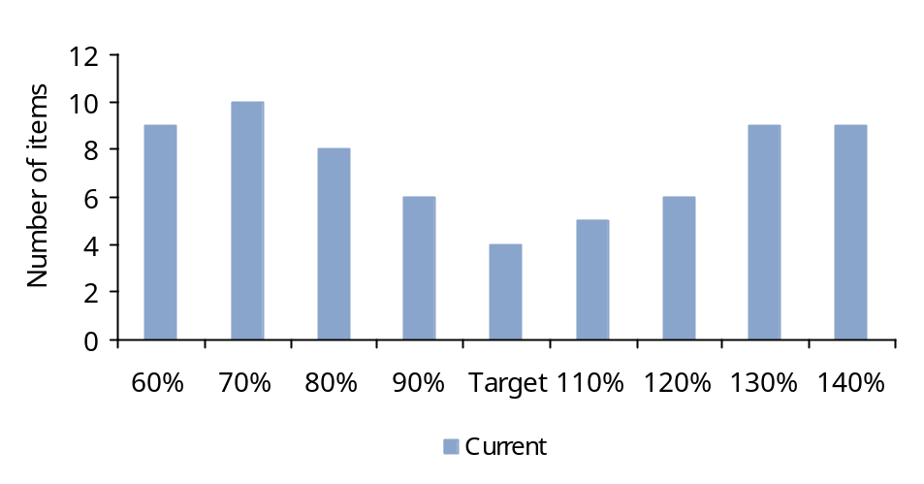
Diagnostic data analysis
6. Inventory coverage analysis (cont.)
Cereal bowl
  Mix of under and over-stocked SKUs
  Attention is given only to some SKUs (i.e. A SKUs, more expensive or critical SKUs) ignoring the rest
  Management of inventory by exception
  Repeating this analysis focusing on specific product categories, segments, geographies or any other criteria can provide additional and valuable insight.

Slide 34
Diagnostic data analysis
7. Consignment Stock Analysis
Objective
  Identify potential excesses or inefficient use of inventory in the consignment stock agreed with customers.
Benefits
  Provides a practical and simple view of consignment stock performance.
  Helps to build a business case to review and renegotiate consignment stock agreements.
How to do it
  For each consignment stock location and for the agreed period of time (at least previous six months) identify:
    Length of time consignment stock agreed for
    Minimum levels of stock agreed
    Inventory value and volume by SKU
    Consumption (sales) by SKU (value and volume)
    Last date of cycling inventory
    Difference in value between theoretical and current existence
  Compare minimum agreed stock, average stock and consumption to identify potential opportunities to reduce stock
    Is minimum agreed stock too high, compared with actual consumption?
    Is average inventory much higher than minimum agreed stock?
    Is average inventory much higher than actual consumption?
    Is actual consumption too low to justify Consignment Stock usage? (Stock rotation less than 4 times a year)

Slide 35
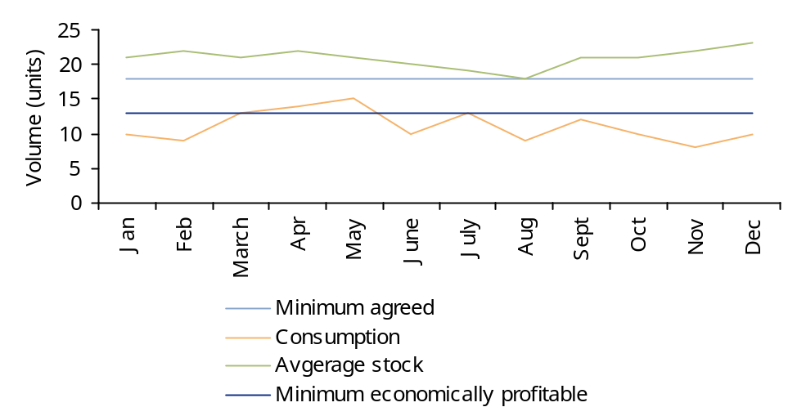
Diagnostic data analysis
7. Consignment Stock Analysis (cont.)
Is average level higher than target?
Consumption below expectations?
Simulate impact of lowering minimum agreed and average inventory, without impacting service level
  Identify opportunities for adjusting minimum and average inventory levels (actual adjustment may require negotiation with customers).
  In those cases where the consignment is not economically viable, the replenishment of SKUs stocked at the respective customer or distributor should stop and customer should be informed.

Slide 36
Diagnostic data analysis
8. Inventory segmentation
Objectives:
  Segment SKUs based on similar behaviour reflecting how the business works. Segmentation criteria could include: Value, volume, demand variability, demand frequency, profitability, customer, etc.
Benefits:
  Provides a snapshot of what type of products are being stocked.
  Quickly identifies those SKUs requiring more attention and potential areas of opportunity.
  Provides insight into issues relating to lack or inconsistency of inventory policies.
  As a diagnostic tool it can help to focus attention on critical SKUs (in terms of cash, cost and service) not being managed properly.
  As a design or implementation tool it can help to define standard policies, processes and targets per segment (e.g. service levels, stockholding points, production frequency, etc.).
How to do it:
  As mentioned above, there are many ways to do a product segmentation. In this document we are going to explain three of them, those more commonly used.
ABC or Pareto classification (based on sales value or volume)
  For the SKUs you want to analyze gather their sales (or consumption) value for the last 12 months as well as the current or average inventory (during the same period of time).
  When the unit cost of different SKUs varies significantly, the sales/usage and inventory figures should be in monetary value (ideally based on Cost of Goods Sold, not on sales price). Otherwise use the sales/usage and inventory data in units.
  Sort list in descending order of sales/usage and assign A, B, C categories based on the cumulative value (A for the SKUs representing the first 80% of the cumulative value, B for those representing the next 15% and C for the remaining 5%).

Slide 37
Diagnostic data analysis
8. Inventory segmentation (cont.)
FMS or demand frequency classification (based on frequency of orders)
  For the SKUs you want to analyze identify a ‘call-off indicator’ and count how many call-offs there have been for each SKU during the selected period. (For example, for Finished Goods an appropriate indicator is the number of orders received for that SKU, while for Semi-finished goods the indicator could be production batches that used the SKU).
  Gather the history of consumption during the last 12 months, based on the chosen ‘call-off indicator’.
  List the SKUs in descending order of their call-off frequency and assign a frequency code (F: For Fast Moving SKUs, M: Medium Moving SKUs, S: Slow Moving SKUs, Z: Zero use SKUs).
  Identifying the boundaries between F, M and S is subjective and may vary with business. It is useful to first look at the data and see if there are clear steps that can be use as categories (see left-hand diagram below). Otherwise, remove items with zero usage and use percentages to assign categories (F for the 10% SKUs with the highest frequency, M for the next 30% and S for the remaining 60%) – as shown in the right-hand diagram.
  Bear also in mind that use and frequency are different concepts and that products with same use may have different frequency.
FMS categorisation when natural steps exist
FMS categorisation using percentages
Fast moving
Fast moving
Fast moving
Fast moving
(step 1)
Fast moving
(step 1)
(step 1)
(10% SKU)
100
(10% SKU)
100
100
100
100
90
90
90
90
90
80
Medium moving
80
Medium moving
Medium moving
Slow moving
80
Slow moving
80
80
(60% SKU)
(step 2)
(60% SKU)
(step 2)
(step 2)
70
70
70
70
70
60
60
60
60
60
Frequency (# orders / year)
Frequency (# orders / year)
Frequency (# orders / year)
50
50
50
50
50
Frequency (# orders / year)
40
40
40
40
40
Slow moving
Slow moving
Slow moving
Medium moving
30
Medium moving
30
30
30
30
(step 3)
(step 3)
(step 3)
(30% SKU)
20
(30% SKU)
20
20
20
20
10
10
10
10
10
0
0
0
0
0
SKU reference
SKU reference
SKU reference
SKU reference
SKU reference

Slide 38
Diagnostic data analysis
8. Inventory segmentation (cont.)
 | Demand product A | Demand product B
Jan 2005 | 145 | 10
Feb 2005 | 123 | 150
Mar 2005 | 111 | 631
Apr 2005 | 100 | 330
May 2005 | 98 | 1
Jun 2005 | 105 | 178
Jul 2005 | 127 | 976
Aug 2005 | 105 | 5
Sept 2005 | 94 | 198
Oct 2005 | 99 | 567
Nov 2005 | 110 | 334
Dec 2005 | 121 | 787
Average | 111.50 | 347.25
Standard deviation | 14.92 | 324.54
Normalised standard deviation | 0.13 | 0.93
HML or demand variability classification (based on the Normalised Standard Deviation of demand)
  For the SKUs you want to analyze calculate the standard deviation of the demand and divide it by the average demand to obtain the Normalised Standard Deviation (NSD) as shown in the example below.
  Plot the SKUs with their respective demand and NSD, identify and remove outliers from your sample.
8,000
7,000
Outliers
6,000
5,000
Monthly Demand - SKUs
4,000
3,000
2,000
Typical distribution of demand
1,000
0
0.0
0.5
1.0
1.5
2.0
2.5
Demand variability (NSD)

Slide 39
Diagnostic data analysis
8. Inventory segmentation (cont.)
  List the SKUs in descending order of their demand variability and assign a code (H For SKUs with High demand variability, M for SKUs with Medium demand variability and L for SKUs with Low demand variability). As in the case of the FMS classification look for natural steps otherwise use a similar 10-30-60 rule.
Combining the classifications
  The real value of the classification comes with their combination, as it provides a new perspective into the inventory understanding. For any combination you are making calculating the following data for each category will be very useful:
    Total value and percentage of consumption
    Total value and percentage of inventory
    Total number and percentage of SKUs
    Average DIO (days of inventory outstanding) or inventory as percentage of sales
For example, combining the ABC and FMS classification you should get a matrix like this (shaded areas indicate the type of products you are likely to find in an ideal situation):
Frequency (orders/year)
  Make to stock SKUs
  SKUs with small batch size produced frequently
  SKUs with high service levels
  Low/JIT component inventory
  SKUs to be stock close to demand
F (>52)
M(52><12)
S(<12)
Z(0)
A (80%)
  Mainly make to order SKUs
  SKUs produced less frequently
  SKUs with lower service levels
  Larger component inventory
  SKUs to be stock close to supply
sales
B (15%)
C (5%)
  Obsolete SKUs or critical spare parts
  Ideally no inventory in this group

Slide 40
Diagnostic data analysis
8. Inventory segmentation (cont.)
By looking at the inventory classification you can focus your analysis in a smaller number of SKUs.
You can also do a first estimation of inventory reduction opportunities (eliminating SKUs in Z category and reducing stock in other segments based on improvement assumptions).
Depending on where most of the inventory value is, the approach to reduce it would be different:
Frequency (orders/year)
High value of stock on the Z category (Frozen working capital)
  High level or risk of obsolescence
  Launch slow moving and obsolete reduction programme
  For critical components and spare parts, review availability and service levels
£
sales
£
£
Frequency (orders/year)
High value of stock on the Slow moving categories
  Risk of obsolescence
  Launch slow moving and obsolete prevention actions
  Evaluate the possibility of converting to Make to Order (MTO)
  Rationalise product portfolio
  Create pricing incentives (move demand to other product)
  Review production frequency and reduce batch sizes
  Remove from local warehouses (centralise availability)
  Lower service level target
£
sales
£
£
£
Frequency (orders/year)
High value of stock on the Fast moving categories
  Change to MTS
  Increase production frequency (weekly / bi-weekly) and reduce batch
  size
  Increase service level target
£
£
sales
£
£

Slide 41
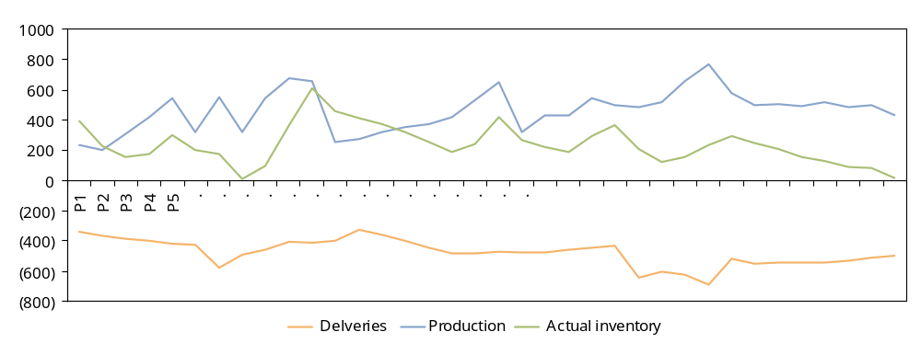
Diagnostic data analysis
9. Time series analysis of inventory
  Objective:
  Identify shifts in supply performance or identify areas where the environment has changed over time:
    Due to supply or demand changes
    Due to internal ‘noise’
  Identify potential issues regarding planning and execution processes of the supply chain both in terms of information and materials (bullwhip factor) creating excess of inventory along the supply chain.
Benefits:
  Provides a graphical understanding of demand trend, seasonality, changes and induced noise.
  Helps to highlight ‘noise’ or demand variability created internally by the existing processes.
How to do it:
For a given product or set of products, group data in weekly buckets and plot demand (shipments), production, and actual inventory.
Identify trend and seasonality behaviours.
Identify outliers and investigate reasons for their occurrence (supply/demand variability, noise, etc.).
Promotion
period
Noise?
Noise?
Units
Trend

Slide 42
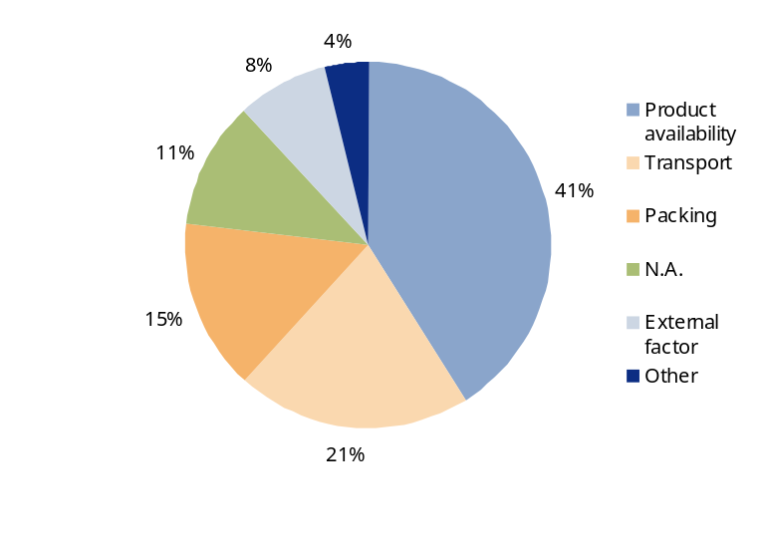
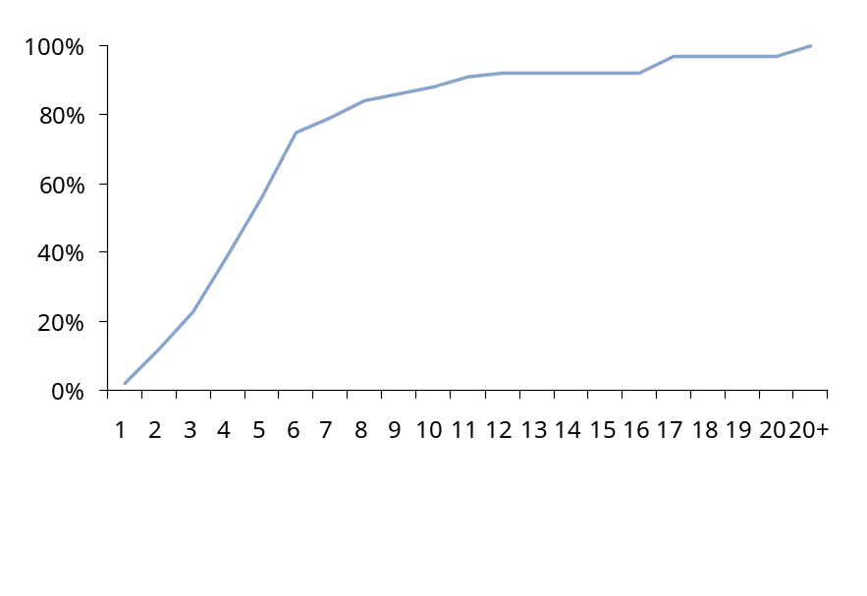
Diagnostic data analysis
10. Late Deliveries Analysis
Objective
  Identify the main reasons for late deliveries and their impact in the overall performance.
Benefits
  Helps to focus attention on main issues affecting on-time delivery measuring their real impact.
How to do it
  Select the SKUs and segment for which you want to make the analysis and define how do you want to measure on-time delivery (against promised delivery date or against requested date).
  For the last 12 months gather the requested/promised and actually delivery dates (Make sure data is available and understand how it has been collected).
  For each order calculate the difference between the requested/promised date and the actual delivery date. Sort in ascending order and exclude those orders delivered earlier or at requested/date.
  Calculate and graph the cumulative percentage of orders (left graph).
  If available in the system, group orders by reason for being late (e.g. product availability, transport issues, packaging errors, short lead time, weather conditions, etc.).
  Calculate and graph the cumulative percentage of orders (right graph).
  Compare both graphs and identify potential correlations.
Percentage of orders
Days late

Slide 43
Diagnostic data analysis
11. Demand Standard Deviation and Mean Average Deviation (MAD) Analysis
Objective
  Measure demand variability in order to understand how predictable or volatile it is. The more volatile the demand the more difficult it would be to forecast.
Benefits
  Provides a quantitative measure of demand variability.
How to do it
  Select the group of SKUs you want to analyse and define the level of demand aggregation you want to understand (business line, family, packing unit, SKU, etc.) and the time unit you want to consider (daily, weekly, monthly, etc.). Bear in mind that variability reduces as data is aggregated into higher hierarchical levels and longer timeframes.
  For the selected SKUs gather their historical demand and remove outliers due to promotions, or on-off events. Calculate the average and the standard deviation. If done in MSExcel, you can use the stdev() formula. You can also calculate it manually as shown in the table below:
 | d(i) Actual demand | D Actual demand | [d(i)-D]^2 (Actual-average)^2
Jan 2005 | 100 | 116 | 251
Feb 2005 | 120 | 116 | 17
Mar 2005 | 110 | 116 | 34
Apr 2005 | 150 | 116 | 1,167
May 2005 | 90 | 116 | 667
Jun 2005 | 120 | 116 | 17
Jul 2005 | 110 | 116 | 34
Aug 2005 | 100 | 116 | 251
Sept 2005 | 100 | 116 | 251
Oct 2005 | 140 | 116 | 584
Nov 2005 | 130 | 116 | 201
Dec 2005 | 120 | 116 | 17
 |  |  | 3,492
Number of months (T) = 12
=
∑[d_{(i)} –D]²
St.dev.
T-1
=
3,492
17.8
=
12-1

Slide 44
Diagnostic data analysis
11. Demand Standard Deviation and MAD Analysis (cont.)
An alternative and simpler method is to calculate the MAD:
Once you have calculated the standard deviation or the MAD sort SKUs in descending order, and identify:
  The SKUs with the higher deviation (generally more difficult to forecast) – which percentage of sales do they represent? What can be done to smoothen their demand?
  The SKUs with the lower deviation (generally easier to forecast ) – which percentage of sales do they represent? How accurate is the forecast? How can it be improved?
 | d(i) Actual demand | D Actual demand | Absolute difference between demand and average
Jan 2005 | 100 | 116 | 16
Feb 2005 | 120 | 116 | 4
Mar 2005 | 110 | 116 | 6
Apr 2005 | 150 | 116 | 34
May 2005 | 90 | 116 | 26
Jun 2005 | 120 | 116 | 4
Jul 2005 | 110 | 116 | 6
Aug 2005 | 100 | 116 | 16
Sept 2005 | 100 | 116 | 16
Oct 2005 | 140 | 116 | 24
Nov 2005 | 130 | 116 | 14
Dec 2005 | 120 | 116 | 4
Mean (MAD) |  |  | 14

Slide 45
Diagnostic data analysis
12. Forecast Accuracy Analysis
Objective:
  Assess the level of accuracy of the existing forecast method being used by the client and identify potential areas of improvement.
How to do it:
  Select the group of SKUs you want to analyse and define the level of demand aggregation you want to understand (business line, family, packing unit, SKU, etc.) and the time unit you want to consider (daily, weekly, monthly, etc.). Ideally each product line, or even SKU, would have a different forecasting method.
  Gather the most recent twelve to eighteen month’s history of forecasts and actual demand.
    Ideally, actual demand should represent true customer demand, not shipments from the warehouses;
    If not it can be estimated as:
  Select the appropriate forecast month to compare (using the latest forecast is not appropriate as it might not reflect the conditions under which replenishment and production decisions were taken). To select the forecast month consider:
    The month in which there is still sufficient lead time to implement changes in the forecast;
    The forecast lead time is a combination of planning lead time, manufacturing lead time and some vendor lead time;
    Once the forecast lead time is known, the appropriate “forecast month” can be determined. For example if forecast lead time is 8 to 10 weeks, then the forecast used will be the one made three months prior to actual demand (e.g. September forecast for January will be compared to January’s actual demand;
Calculate the forecast error as:
Customer demand = shipments - returns + month-end back orders - month beginning back orders
Forecast error_{n} = [Forecasted sales_{n} – Actual sales_{n}] / Actual sales_{n}

Slide 46
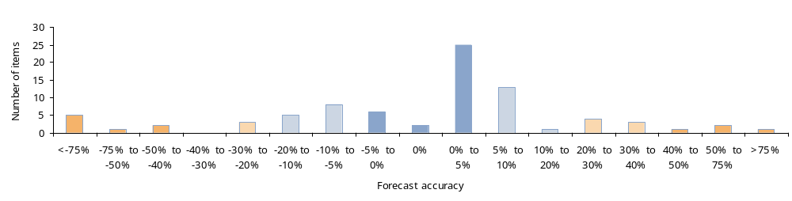
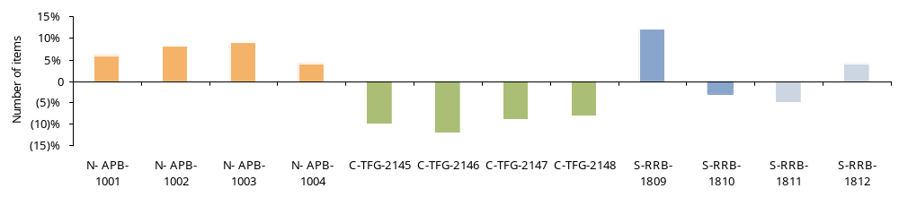
Diagnostic data analysis
12. Forecast Accuracy Analysis (cont.)
  Group SKUs based on their forecast error and plot a histogram to assess overall forecast accuracy:
Under forecast
Over forecast
  Look for consistent bias by product groups, customer segment, region, etc. Explore reasons for bias.
Region N—positive biased
Region C—negative biased
Region S—unbiased

Slide 47
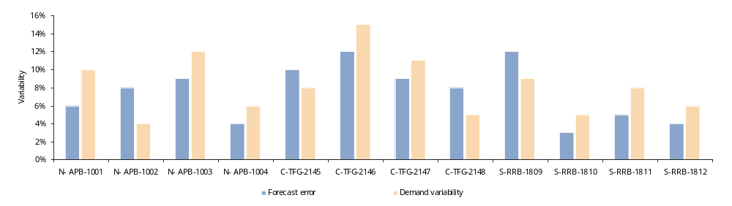
Diagnostic data analysis
12. Forecast Accuracy Analysis (cont.)
  For the SKU’s with low and medium forecast accuracy identify if forecast is helping to predict demand variability or creating more uncertainty instead.
Forecast reduces
uncertainty
Forecast adds
uncertainty

Slide 48
Diagnostic data analysis
13. Actual vs. Theoretical Stock parameters analysis
Objective
  Assess whether existing stock parameters (EOQ, MBS, and ROP) are too high when compared against theoretical levels.
Benefits
  Provides a graphical understanding of the gap between the existing and the theoretical stock parameters (EOQ, MBS, ROP). The visual presentation makes it easier to client to understand the issue and facilitates the discussion, however the calculation of the theoretical parameters could take longer and might not be achievable during a Diagnostic phase.
How to do it
  Select the parameter you want to compare and make sure you have both the actual and the theoretical level for it.
  For the selected SKUs plot the actual value of the parameter against the theoretical one (See formulas on previous section) in a XY (scatter) type graph, where the X-axis corresponds to the current value and the Y-axis corresponds to the theoretical one. (see a similar graph in the Actual vs. Theoretical Inventory targets section).
  On the graph, draw a line at 45o line. This line indicates those SKUs for which the actual value of the parameter matches exactly the theoretical one. Now identify:
    SKUs above the line—For these SKUs current value of the parameter is below theoretical level. While this might be more inefficient in terms of cost and time it is not necessarily wrong and you need to understand the operational and financial constraints behind;
    SKUs below the line—For these SKUs actual value of the parameter is above theoretical value. Initially these SKUs represent an opportunity for reduction, however as in the previous case there might be plenty of reasons why the theoretical value are not achievable. A detailed analysis of these SKUs is required.

Slide 49
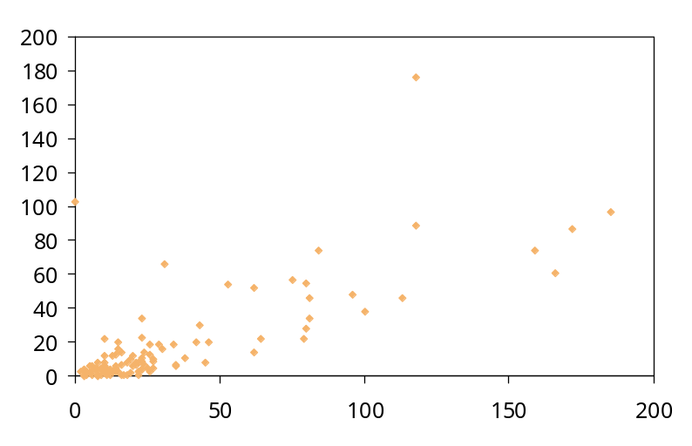
Diagnostic data analysis
13. Actual vs. Theoretical inventory targets analysis
Objective
  Assess whether existing inventory levels and/or targets are too high when compared against theoretical targets.
Benefits
  Provides a graphical understanding of the current inventory levels and targets against theoretical target levels. The visual presentation makes it easier to client to understand the issue and facilitates de discussion.
How to do it
  For the selected SKUs plot their actual inventory level against their theoretical target level (Please refer to the Inventory Modeling document, to learn how to calculate the inventory target level) in a XY (scatter) type graph, where the X-axis corresponds to the actual inventory level and the Y-axis corresponds to the target.
  On the graph, draw a line at 45o. This line indicates those SKUs for which current inventory equals inventory target level. Now identify:
    SKUs above the line—For these SKUs actual inventory level is below theoretical target;
    SKUs below the line—For these SKUs actual inventory is above theoretical target.
Actual Inventory
below target
Potential need to
increase inventory
Theoretical Target (und)
Actual Inventory above target
Potential opportunity for reduction
Investigate alternatives!!
Actual inventory (und)

Slide 50
Diagnostic data analysis
14. Review of current stock parameters
Objective:
  Assess whether parameters such as Economic-Order-Quantity (EOQ), Minimum Batch Size (MBS), Reorder-Point (ROP) are very conservative or not being properly calculated.
  Identify potential opportunities to reduce inventory by adjusting these parameters.
Benefits:
  By using very simple analysis, demonstrate to the client the limitations of existing inventory management practices and their impact in increasing inventory.
How to do it:
  Before starting, remember a few definitions: (you are not going to use them in this analysis).
Economic-Order-Quantity (EOQ): Is the optimal number of units that a company should add to inventory with each order to minimize the total costs of inventory—such as holding costs, order costs, and shortage costs. When talking about a produced item it is also known as the Minimum Batch Size (MBS)
2 x Cost/Order(£) x Total annual Sales (Qty)
EOQ
=
Unit Cost (£) x Carrying Cost(£)
Re-order Point: Corresponds to the inventory level at which an order has to be placed in order to minimize the sum of annual holding, ordering, and shortage costs while ensuring material availability to serve customer orders. The Re-Order-Point is the average demand during the average supplying lead-time added to the safety stock.
ROP
=
Safety stock + (Daily demand x Lead Time _{in days})

Slide 51
Diagnostic data analysis
14. Review of current stock parameters (cont.)
  For the selected SKU, gather the existing EOQ (or MBS), ROP and lead-time (LT). Normally these parameters should be available on the system. If they are not ask yourself if this is an indicator of poor inventory management.
  Based on the last 12 months history of orders calculate the average reorder quantity (excluding outliers).
  Taking into account historical data, calculate the average day of sales or consumption for each SKU.
  Express EOQ, MBS, ROP and average reorder quantity in days of consumption and compare against LT.
SKU | Stock on hand (£) | Stock on hand (days) | Lead time (days) | Orders in 2004 (kg) | Average ROQ (days) | EOQ (days) | ROP (days)
DRM038 | 48,948 | 312 | 21 | 11/02/04: 2,557 11/02/04: 2,612 11/06/04: 2,868 09/09/04: 2,597 14/09/04: 2,647 | 72 (2,656kg) | 68 (2,500 Kg) | 95 (3,478kg)
DRB001 | 79,833 | 111 | 21 | 27/01/04:9,903 08/03/04: 9,903 13/04/04:9,903 24/06/04: 9,904 24/08/05: 9,904 21/10/04: 9,904 15/12/04: 13,204 | 40 (10,270Kg) | 39 (10,000Kg) | 59 (1500Kg)
DIV002 | 33,751 | 202 | 32 | 9 orders | 45 (8,656Kg) | 52 (10,000Kg) | 90 (17,307Kg)
IE014 | 29,299 | 186 | 32 | 03/03/04: 7,171 09/03/04: 10,000 02/12/04: 5,000 | 122 (4,390Kg) | 139 (5,000Kg) | 69 (2,500Kg)
RK104 | 12,651 | 46 | 21 | 35 orders | 10 (29Kg) | 9 (25Kg) | 18 (50Kg)
  Identify cases where MOQ and EOQ seem extremely high compared to LT , or where average ROQ exceeds EOQ and try to understand what is the reason behind them

Slide 52
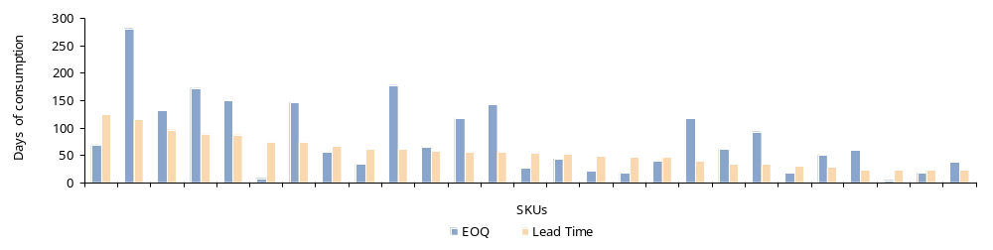
Diagnostic data analysis
14. Review of current stock parameters (cont.)
  You can also plot both parameters into a bar chart and see graphically the SKUs with the highest differences.
Potential to reduce current EOQ?
  By looking at the table and/or graph, identify the SKUs for which MOQ and EOQ seem extremely high compared to LT , or where average ROQ exceeds EOQ and try to understand what is the reason behind them, considering:
    Transport restrictions (e.g. Minimum batch size is less than a full truck load, requiring to take larger orders to maintain transport cost down);
    Supplier restrictions (e.g. Supplier does not sell below certain batch sizes);
    Parameters were set long time ago and haven’t been challenged since;
    Operations people receive incentives based on output volume;
    …

Slide 53
Diagnostic data analysis
15. Fill rate and lead time analysis
Objective
  Assess actual service level and identify potential inconsistencies among the service level offered and provided for different customer segments, products, etc.
  Obtain a deeper understanding of service level issues.
Benefits
  Helps to build a sounding case for understanding the real status of service level seen not only as a marketing measure but as a real variable to affect inventory levels.
  Provides new insights into service level inconsistencies.
  These analysis might be restricted by the limited availability of data and/or time during the diagnostic phase. Ideally they should be done a a second step to obtain additional insight into an specific group of SKUs or segment.
How to do it
  Before starting, remember that there are two main dimensions to measure service level:
Fill Rate: Measures much of what was ordered was actually received within the stated lead time. It can be measured by:
  Item: The number of units (or cases) received as a percentage of the total ordered (Simplest measure, important for businesses where orders are large relative to sales volume)
  Line: The number of different ‘line items’ received (exactly at their requested quantity) as a percentage of the total number of line items ordered (Tougher measure, helps to identify which products are in short supply and very useful for stock replenishment SKUs)
  Order: The number of orders received (at exactly their requested quantity on each line item) as a percentage of the total number of ordered (Toughest measure, very useful for orders required in full as in the case of project orders and orders for overseas delivery)
Lead time: How promptly was a customer’s order received? It is measured using the on-time delivery indicator comparing the elapsed time from the date an order is placed by a customer to the date it is delivered against the requested or promised delivery dates. Measuring it against promised date indicates reliability while measuring it against requested date indicates effectiveness of service

Slide 54
Diagnostic data analysis
15. Fill rate and lead time analysis (cont.)
Fill Rate Analysis
  Select the SKUs and segment for which you want to make the analysis and define at which point of the supply chain you want to measure it (normally for Finished Goods you measure it as real deliveries to customers).
  Decide at which level you want to measure service level (i.e. Item, line or order).
  For the last 12 months gather the requested and actually delivered volume (Make sure data is available and understand how it has been collected).
  For each order calculate the fill rate by dividing the total number of requested units (depending upon your selected level) by the total of delivered units (see example).
 | Requested |  | Delivered
 | Item A | Item B | Item A | Item B
Order | 100 | 100 | 90 | 100
1001 | 100 | 100 | 90 | 100
1002 | 100 | 100 | 90 | 100
1003 | 100 | 100 | 100 | 100
1004 | 100 | 100 | 100 | 100
1005 | 100 | 100 | 100 | 100
1006 | 100 | 100 | 100 | 100
1007 | 100 | 100 | 100 | 100
1008 | 100 | 100 | 100 | 100
1009 | 100 | 100 | 100 | 100
1010 | 100 | 100 | 100 | 100
Total | 1,000 | 1,000 | 970 | 1,000
 | Requested (A) | Delivered (B) | Fill rate (A/B)
Total items | 2,000 | 1,970 | 99%
Total lines | 20 | 17 | 85%
Orders | 10 | 7 | 70%

Slide 55
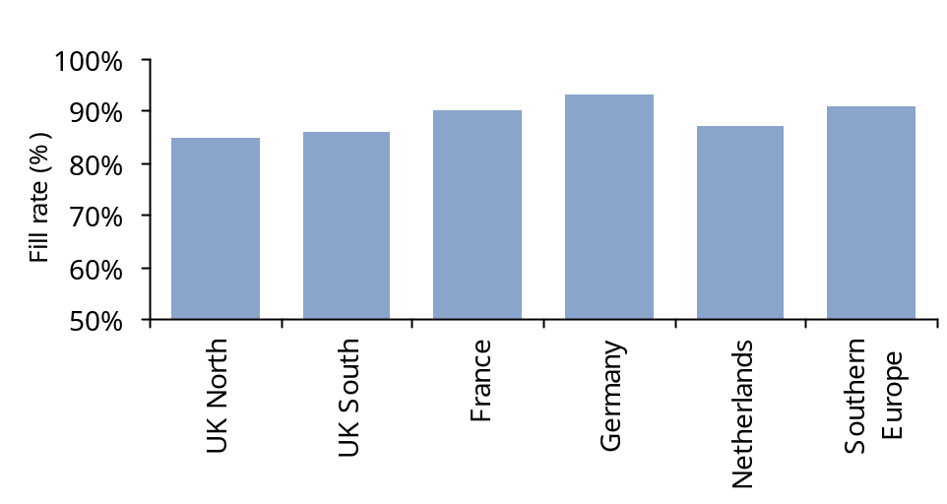
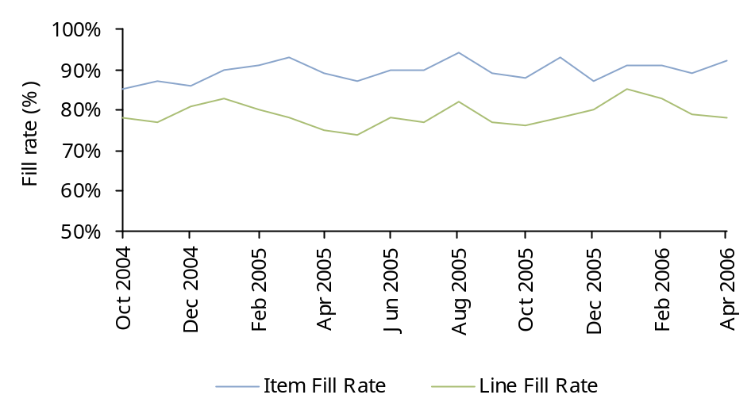
Diagnostic data analysis
15. Fill rate and lead time analysis (cont.)
  Plot the fill rate in a line or bar chart where the Y axis corresponds to the service level and the X to the month (for time series), the segment, geography, or any other criteria you are using to do the comparison.
Lead Time Analysis (The S curve)
  Select the SKUs and segment for which you want to make the analysis and define how do you want to measure on-time delivery (against promised delivery date or against requested date).
  For the last 12 months gather the requested/promised and actually delivery dates (Make sure data is available and understand how it has been collected).
  For each order calculate the difference between the requested/promised date and the actual delivery date. Sort in ascending order.
  Calculate and graph the cumulative percentage of orders as show in the next slide.

Slide 56
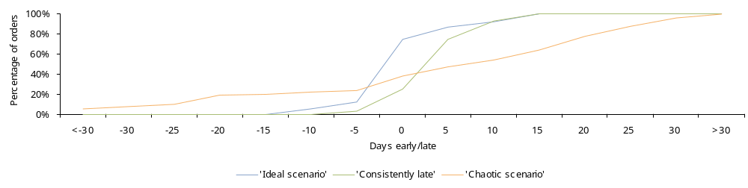
Diagnostic data analysis
15. Fill rate and lead time analysis (cont.)
  By reviewing at the graph you can get a good understanding on how good the on-time delivery is:
    In the ‘ideal scenario’ the graph would take a S shape, indicating that most of the orders are delivered on time or with minor differences (zero days or plus/minus a small difference);
    A displaced S-shape (such as the ‘Consistently late’ scenario shown on the graph) could be caused by operational or management constraints and sometimes are not perceived as an issue by the client due to their consistency behaviour, however they still represent an opportunity for improvement;
    A wide-open S-shaped line would reflect amore ‘chaotic scenario’ in which there is not any consistency in terms of delivery time to customer. This can reflect significant issues requiring attention.

Slide 57
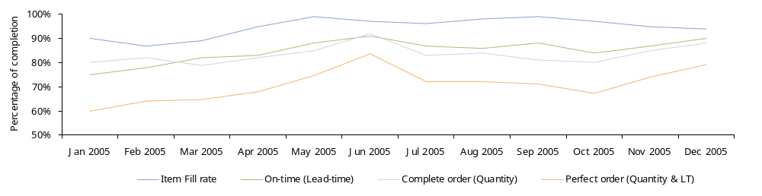
Diagnostic data analysis
15. Fill rate and lead time analysis (cont.)
  A third alternative is to use a combined analysis as shown below:
Combined analysis

Slide 58
Appendix 1
Inventory Management Network

Slide 59
Appendix 1
Inventory management network (March 2008)
Country | First name | Last name | Phone number | E-mail
UK | Miguel | Zapata | +44 (0) 20 7311 4279 | miguel.zapata@kpmg.co.uk
UK | Steve | Barron | +44 (0) 20 7311 4596 | steve.barron@kpmg.co.uk
US | Tracey | Kellerman | 1 415 963 5442 | tlkellerman@kpmg.com
Germany | Uwe | Achterhold | +49 (89) 9282-1355 | uachterholt@kpmg.com
Australia | James | Allt-Graham | +61 (2) 9335 7084 | jalltgraham@kpmg.com.au
Netherlands | Raymond | DeLooze | +31 (73) 680 16 16 | delooze.raymond@kpmg.nl
Italy | Marta | Bona | 011 836036 | mbona@kpmg.it
India | Raghu | Venkatnarayan | +91 (44) 3914 5203 | rvenkatnarayan@kpmg.com
South Africa | Lucille Jansen | van Vuuren | +27 (11) 647-8731 | lucille.jansenvanvuuren@kpmg.co.za
Canada | Nick | Seiersen | +1 416 777 8391 | nseiersen@kpmg.ca
Spain | Francisco | Rollon | (34) 914563400 | frollon@kpmg.es
Brazil | Fernando | Aguirre | +55 (11) 2183-3125 | fernandooliveira@kpmg.com.br
Singapore | Jarrod | Magill | +65 (6411) 8016 | jarrodmagill@kpmg.com.sg
Russia | Andrei | Novistsky | +7 (495) 9374444 ext:3241 | anovitsky@kpmg.ru
Korea (Rep. of) | II | Cho | +82 (2) 2112 0286 | ilcho@kr.kpmg.com
Switzerland | Roger | Mueller | +41 (44) 249 4535 | rogermueller@kpmg.com
Ireland | Brian | Rooney | +353 (1) 700 4040 | brian.rooney@kpmg.ie
Mexico | Aldo | Piedras | +52 (55) 52468300 | piedras.aldo@kpmg.com.mx
Poland | Lidia | Szabelewska | +48 (22) 528 1079 | lszabelewska@kpmg.pl
Sweden | Carl | Lindgren | +46 (8) 7239328 | carl.lindgren@kpmg.se
Hungary | Karoly | Teleki | +36 (1) 887745 | karoly.teleki@kpmg.hu
Greece | Stavroula | Minasidou | +30 (210) 6062384 | sminasidou@kpmg.gr
Norway | Lars Erik | Maseide | +47 40639217 | lars.erik.maseide@kpmg.no
Czech Republic | Daniel | Kozeny | 420 222 123 208 | dkozeny@kpmg.cz
Bahrain | Rajesh | Menon | +973 17224807 | rmenon@kpmg.com

Slide 60
Appendix 2
Acronyms

Slide 61
Appendix 2
Glossary of terms
BOM | Byte Order Mark
CEO | Chief executive officer
COGS | Cost of goods sold
DG | Diagnostic
DIA | Days of inventory available
DIA_{p} | Days of inventory available period
DIO | Days of inventory outstanding
DIO_{p} | Days of inventory outstanding period
EOQ | Economic order quantity
FD | Finance director
FG | Finished goods
FMCG | Fast moving consumer goods
FTD | Forecast to deliver
KPI | Key performance indicator
LT | Lead time
MAD | Mean average deviation
MBS | Minimum batch size
NPD | New product development
NSD | Normalised standard deviation
OTIF | On time in full
RA | Rapid assessment
Raw Mat | Raw materials
RM | Raw materials
ROP | Re-order point
ROQ | Re-order quantity
S&OP | Sales operations and planning
SKU | Stock keeping unit
OTC | Order to cash
PTP | Purchaser to pay
VMI | Vendor managed inventory
WIP | Work in progress

Slide 62













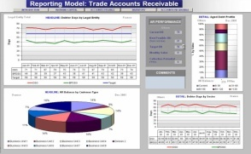
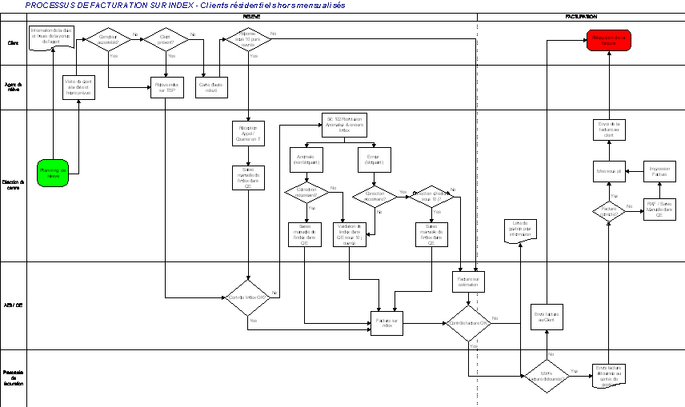
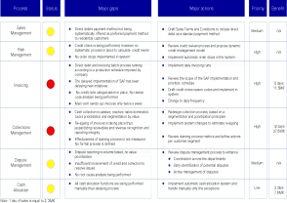
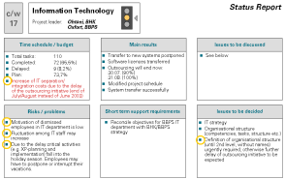
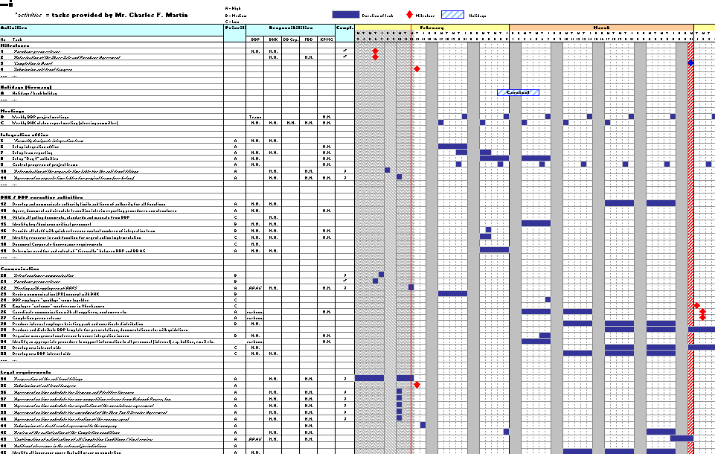
Overview of Approach for Release of Working Capital Opportunities
KPMG’s approach focuses on understanding cash and working capital performance from both an analytical as well as from an operational point of view.
Assess
process, policy
and organisation
Identify gaps to better practice
Evaluate root causes
Quantify
Improvement potential for
short to
medium term
Prepare
action plan
Interviews
4
Actual
performance
Analyze systems, tools and information accuracy
Assess Cash Flow and Working Capital performance
1
Workshops
Establish
performance
baseline
Assess key performance drivers and root causes
2
3
Best Possible
performance
Analyze
reporting, KPIs,
and incentives
Data analysis
Analyse
staffing levels, and
competences.
HR
Example Deliverables
Performance review
and target setting
Process maps
Best practice
gap analysis
Detailed
recommendations
Action planning

